Slide 1
What is the Gospel?

Slide 2
5 counterfeit “gospels”
Acquisition - Universalism - Annihilation
Relativism – Good works

Slide 3
The authentic Gospel!

Slide 4
Romans 8:1
“Therefore, there is now no condemnation for those who are in Christ”

Slide 5
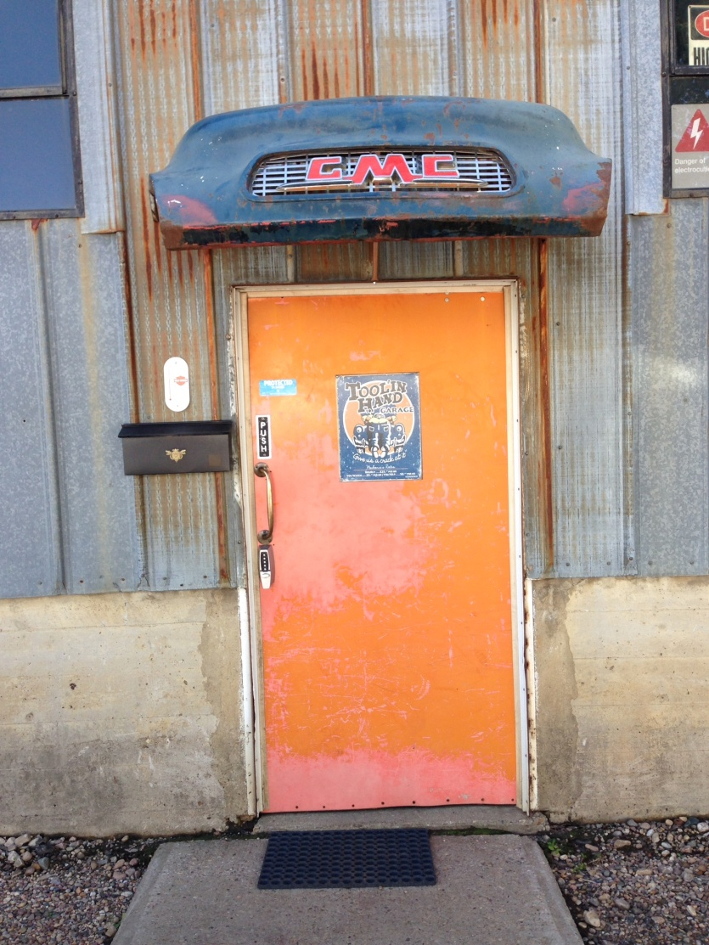
GMC

Slide 6
God = Man = Christ
God = loving
Jeremiah 31:3b
John 3:16
Romans 5:8
God = just
Exodus 34: 7a
Revelation 20:12,13
Man = sinful
Isaiah 53:6
Romans 3:23
Man = separated
Romans 6:23
Christ = humanity
Hebrews 4:15
Christ = divinity
Philippians 2:5-8

Slide 7
Receiving the Gospel!
The parable of the Sower
Mark 4:1-20
Confess = 1 John 1:9
Repent = Mark 4:15
Believe = Romans 10:9

Slide 8
Sharing the Gospel!
“How beautiful on the mountains are the feet of those who bring good news, who proclaim peace, who bring good tidings, who proclaim salvation, who say to Zion, ‘Your God reigns!’”
Isaiah 52:7

Slide 9
Declaratory = Peter
“Then Peter stood up with the Eleven, raised his voice and addressed the crowd: ‘Fellow Jews and all of you who live in Jerusalem, let me explain this to you; listen carefully to what I say.’”
Acts 2:14

Slide 10
Intellectual = Paul
Acts 17:1-4
“When Paul and his companions had passed through Amphipolis and Apollonia, they came to Thessalonica, where there was a Jewish synagogue. As was his custom, Paul went into the synagogue, and on three Sabbath days he reasoned with them from the Scriptures, explaining and proving that the Messiah had to suffer and rise from the dead. ‘This Jesus I am proclaiming to you is the Messiah,’ he said. Some of the Jews were persuaded and joined Paul and Silas, as did a large number of God-fearing Greeks and quite a few prominent women.”

Slide 11
Testimonial = The healed blind man
John 9:8-11
“His neighbors and those who had formerly seen him begging asked, ‘Isn’t this the same man who used to sit and beg?’ Some claimed that he was. Others said, ‘No, he only looks like him.’ But he himself insisted, ‘I am the man.’ ‘How then were your eyes opened?’ they asked. He replied, ‘The man they call Jesus made some mud and put it on my eyes. He told me to go to Siloam and wash. So I went and washed, and then I could see.’”

Slide 12
Interpersonal = Matthew
Luke 5:27-32
“After this, Jesus went out and saw a tax collector by the name of Levi sitting at his tax booth. ‘Follow me,’ Jesus said to him, and Levi got up, left everything and followed him. Then Levi held a great banquet for Jesus at his house, and a large crowd of tax collectors and others were eating with them. But the Pharisees and the teachers of the law who belonged to their sect complained to his disciples, ‘Why do you eat and drink with tax collectors and sinners?’ Jesus answered them, ‘It is not the healthy who need a doctor, but the sick. I have not come to call the righteous, but sinners to repentance.’”

Slide 13
Invitational = Samaritan woman
“Just then his disciples returned and were surprised to find him talking with a woman. But no one asked, ‘What do you want?’ or ‘Why are you talking with her?’ Then, leaving her water jar, the woman went back to the town and said to the people, ‘Come, see a man who told me everything I ever did. Could this be the Messiah?’ ... Many of the Samaritans from that town believed in him because of the woman’s testimony, ‘He told me everything I ever did.’ So when the Samaritans came to him, they urged him to stay with them, and he stayed two days. And because of his words many more became believers. They said to the woman, ‘We no longer believe just because of what you said; now we have heard for ourselves, and we know that this man really is the Savior of the world.’”
John 4:27-29; 39-42

Slide 14
Service = Dorcas
Acts 9:36-42
“In Joppa there was a disciple named Tabitha (in Greek her name is Dorcas); she was always doing good and helping the poor. About that time she became sick and died, and her body was washed and placed in an upstairs room. Lydda was near Joppa; so when the disciples heard that Peter was in Lydda, they sent two men to him and urged him, ‘Please come at once!’ Peter went with them, and when he arrived he was taken upstairs to the room. All the widows stood around him, crying and showing him the robes and other clothing that Dorcas had made while she was still with them. Peter sent them all out of the room; then he got down on his knees and prayed. Turning toward the dead woman, he said, ‘Tabitha, get up.’ She opened her eyes, and seeing Peter she sat up. He took her by the hand and helped her to her feet. Then he called for the believers, especially the widows, and presented her to them alive. This became known all over Joppa, and many people believed in the Lord.”

Slide 15
Spiritual C.P.R.
Cultivate - Plant - Reap

Slide 16
Application
Pray
Who comes to your mind?
Possible opportunities
Prepare
Testimony
Watch – look – listen - share

